Slide 1

An introduction to Multi-Variate Pattern Analysis (MVPA) using scikit-learn & nilearn and The RSA Toolbox
COGNESTIC, 2025
Daniel Mitchell
Daniel.Mitchell@mrc-cbu.cam.ac.uk

Slide 2
Plan for the day
9:05 – 10:00 | Introduction to MVPA Introduction to scikit-learn (and alternative toolboxes) First example – simulated data, with true effect across two voxels
Break
10:15 – 11:00 | Partitions and cross-validation Different classifiers Different output measures Exercises
Break
11:15 – 12:00 | Exercises continued Examples with real fMRI data Which features to use (ROIs, searchlights)? Statistics & permutation
LUNCH
13:00 – 14:00 | Introduction to RSA Introduction to the RSA Toolbox; dataset demos
Break
14:15 – 15:00 | Dissimilarities, RDMs, visualisations
Break
15:15 – 16:00 | More RSA Toolbox demos: Model RDMs, statistics, searchlight
16:30 - | PI talk by Kate Baker

Slide 3
Part 2: RSA

Slide 4
What is RSA?
“Representational Similarity Analysis (RSA) is an MVPA method to: describe and compare geometries of represented conditions
Generalisation of classification:
More conditions
More general notion of dissimilarity (not “are patterns different?” but “how different are they?” and “how are they different?”)
Less need to predefine stimulus categories/dimensions
Notes:
(Assumes that the concepts can be embedded in a high-dimensional space, and that the measurements sample this space)

Slide 5
Why do RSA?
Quantifies neural relationships between conditions in an abstract space, derived from, but no longer dependent on, the measurement format…
Allows different representational structures to be distinguished, and compared in common format
Kriegeskorte et al. 2008

Slide 6
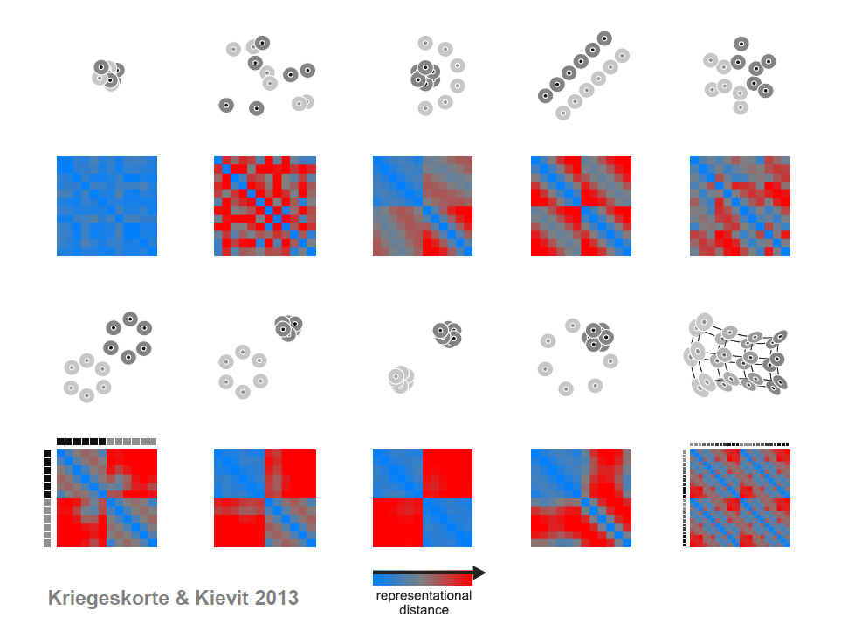
Richer description than classification:
Kriegeskorte & Kievit (2013)
Notes:
Each example shows six stimuli from two conditions.
Blue lines show cases where a linear classifier would give identical (and in this case perfect) classification, despite clearly different representational structure that would be picked up by RSA.
Similarly, red lines show identically performing non-linear classifiers, despite different representational geometries.
The RDMs under each case capture all the relevant differences.

Slide 7
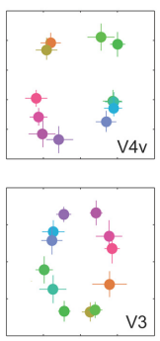
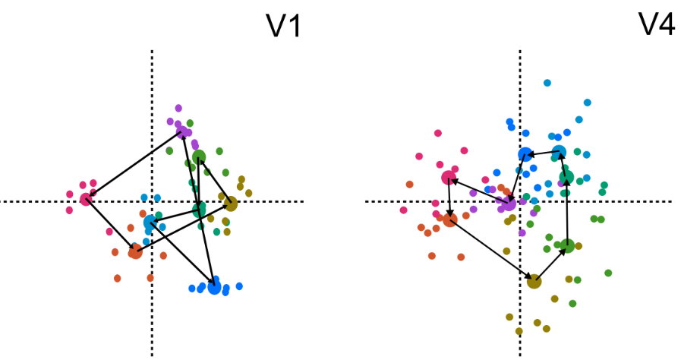
A real example
Classification of colour strongest in V1
But representation in V4 more closely matches perceptual colour space
Stimulus responses also cluster by category in V4 (in colour-naming task)
Brouwer & Heeger 2009, 2013

Slide 8

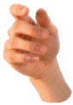
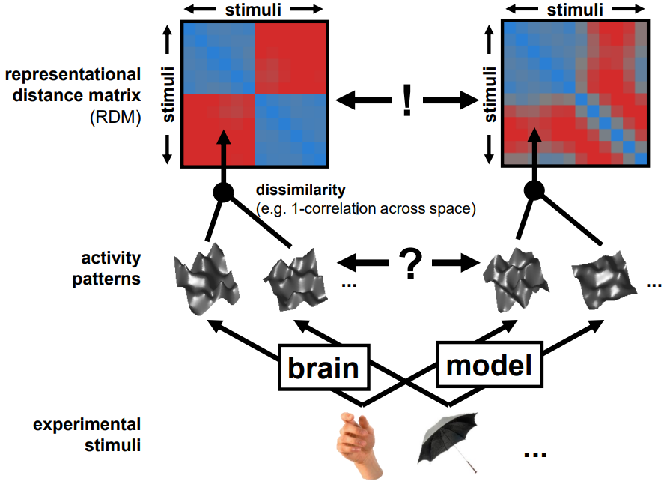
How does it work – the “Representational Similarity Trick”
RSA
dissimilarity
Voxel Receptive Field Modelling
(many parameters & little generalization)
Image from
Niko Kriegeskorte
RSA workshop 2015

Slide 9
Kriegeskorte et al. 2008

Slide 10
Representational similarity analysis using The RSA Toolbox

Slide 11
What is The RSA Toolbox?
Original Matlab implementation described in Nili et al. (2013), and can be downloaded here: http://www.mrc-cbu.cam.ac.uk/methods-and-resources/toolboxes/ Or here: https://git.fmrib.ox.ac.uk/hnili/rsa
Current development in Python (briefly called PyRSA, now called RSA 3.0): https://github.com/rsagroup/rsatoolbox See Schütt et al., eLife, 2023

Slide 12
Why use the (Python) RSA Toolbox?
Pros:
Open source
Decent documentation and multiple demos
Few dedicated alternatives
Other toolboxes (e.g. The Decoding Toolbox and CoSMoMVPA) have some RSA capability, but less documented/comprehensive
BrainIAK has a particular Bayesian version
Others?
Flexible/sophisticated statistics/modelling
Attractive/clever visualisations
Cons:
Dedicated to RSA, not classification (but crossnobis distance is an excellent classification measure)
Sometimes non-intuitive (“Euclidean” is squared Euclidean; may semi-overlapping bootstrap functions?)
Still in development – e.g. searchlight and some demos only partially implemented

Slide 13
Setting up the environment for these demos:
(One option: certainly not the only one; likely not the best)
conda create –n cognestic24 python
conda activate cognestic24
conda install –c anaconda jupyter [used for demos]
conda install –c anaconda spyder [optional, IDE]
Clone RSA Toolbox github repository and move to its directory
pip install .
[or: conda install -c conda-forge rsatoolbox]
pip install –U nilearn
pip install seaborn [optional, used for some demos]
Packages to probably import:
import numpy, scipy, matplotlib, rsatoolbox
Packages to possibly import:
import os, glob, pandas, collections, nilearn, nibabel, seaborn
Notes:
numpy provides arrays
scipy can load .mat files with io.loadmat and adds other matlab functionality like squareform
matplotlib provides matlab-like plotting
seaborn extends/simplifies matplotlib with more plot types and options (like despine to (re)move axis lines)
os provides methods like path.join
glob to search filenames with wildcards
pandas provides dataframes (i.e. tables)
collections provides extra datatypes e.g. defaultdict
nibabel can process analyze/nifti files with load() and load().get_fdata
nilearn for neuroimaging stuff like “plotting.plot_stat_map”
Can do: from [package] import [module] as [newname]
To use VScode:
Install Remote SSH
Click green button at bottom left; connect current window to host
Enter e.g. dm01@login-j03 + password
“conda env list” to see available environments
“conda list” to see software in active environment

Slide 14
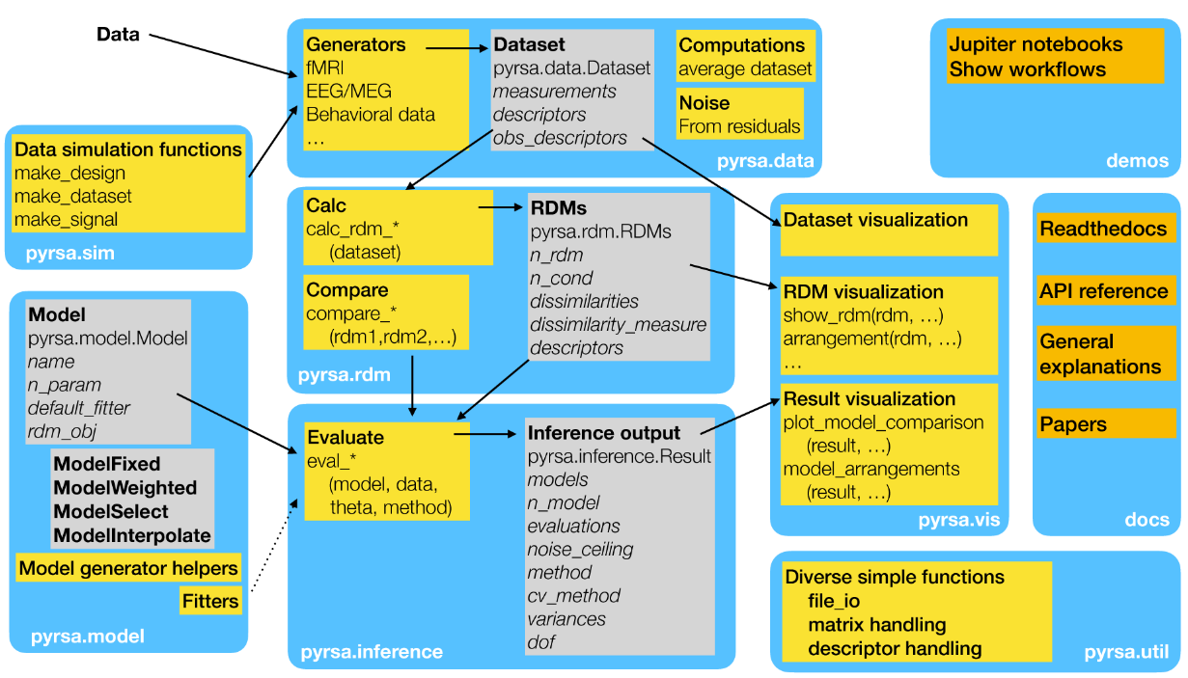
Overview:
How does The RSA Toolbox work?
Notes:
blue: sub-packages
grey: classes
yellow: modules (functions)
orange: auxiliary materials

Slide 15
Some key components: Datasets and RDMs
How does The RSA Toolbox work?
data.Dataset [or data.TemporalDataset]
[ observations x channels [ x time] ]
from numpy array, pandas dataframe or .hdf5 file
Optional dataset/obs/channel descriptors, as dictionary of lists
Methods to: sort, split, subset, average
data.noise to estimate noise covariance/precision,
from measurements or residuals
demo_dataset
(create, describe,
and rearrange
datasets) (~5 s)
e.g. RDMs = rdm.calc_rdm(Dataset, method='euclidean‘)
RDMs = rdm.calc_rdm_movie(TemporalDataset, …)
RDMs = rdm.calc_rdm_unbalanced(…)
rdm.RDMs
[ n x patterns x patterns ] or [ n x upper triangular vector]
Optional RDM/pattern descriptors, as dict of lists
Methods to:
concatenate, append, subsample and average RDMs
subsample, reorder, or sort patterns (i.e. conditions)
transform data (e.g. rank, or sqrt)
compare RDMs (e.g. types of correlation)
To create an RDM, we need to define dissimilarity…
Notes:
descriptors – dict with general metadata about dataset
obs_descriptors – dict with array that defines condition labels
channel_descriptors – dict with array that identifies each channel
For multiple subjects, use a list of Datasets

Slide 16
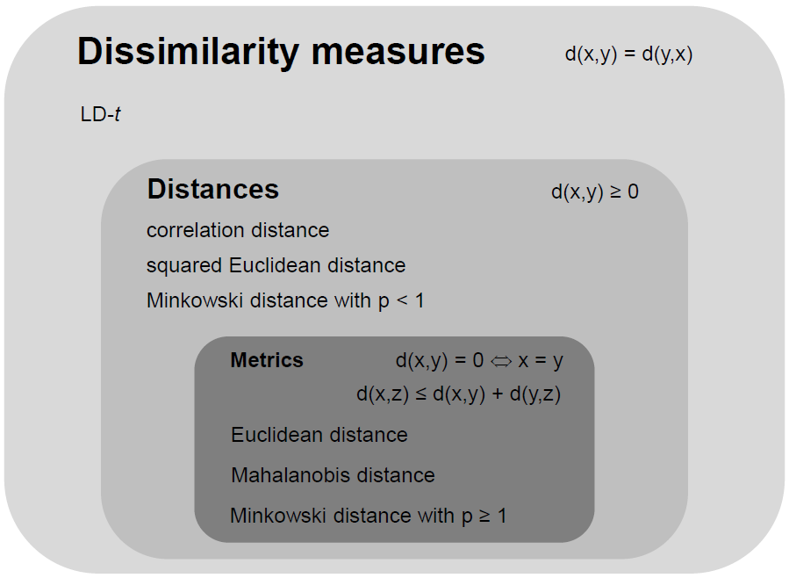
How to measure representational dissimilarity
and other cross-validated “distance estimates”
Image from
Niko Kriegeskorte
RSA workshop 2015

Slide 17
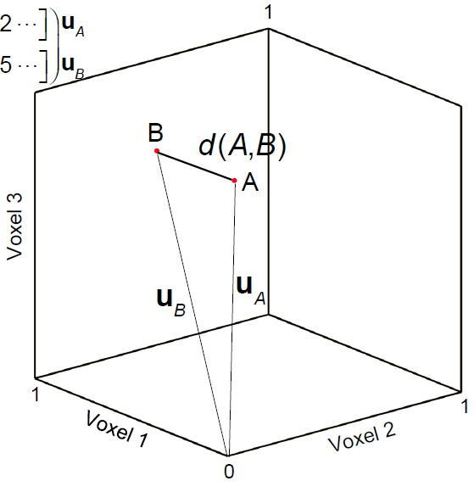
Euclidean distance
Straight-line distance between two patterns in Euclidean space
Image from Alex Walther
RSA workshop 2015
Notes:
Square root of sum of squared displacements along orthogonal dimensions

Slide 18
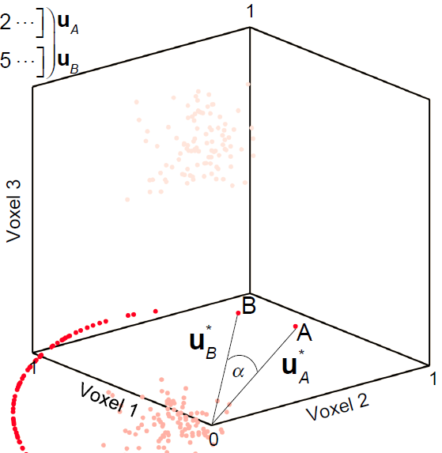
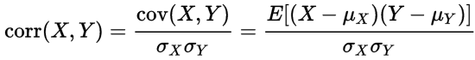
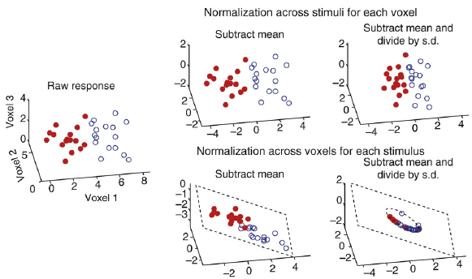
Correlation distance
1 – correlation coefficient
Correlation = cosine of the angle between normalised patterns
Image from Alex Walther
RSA workshop 2015
Misaki et al. 2010
Notes:
Cosine similarity is dot product of unit vectors.
Pearson correlation is cosine similarity between centred vectors.
Spearman correlation is Pearson correlation between ranked vectors.

Slide 19
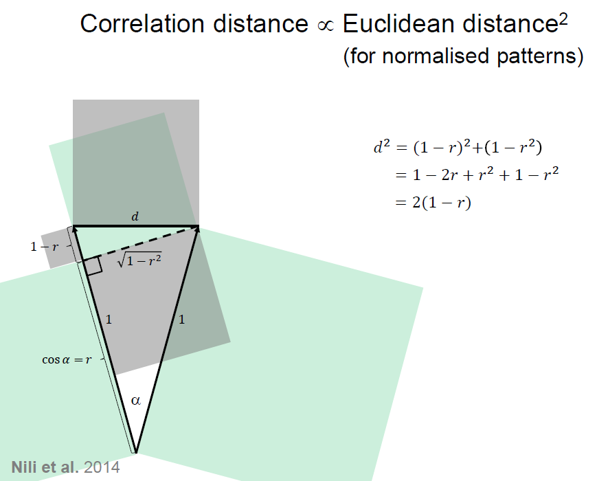
Image from
Niko Kriegeskorte
RSA workshop 2015

Slide 20
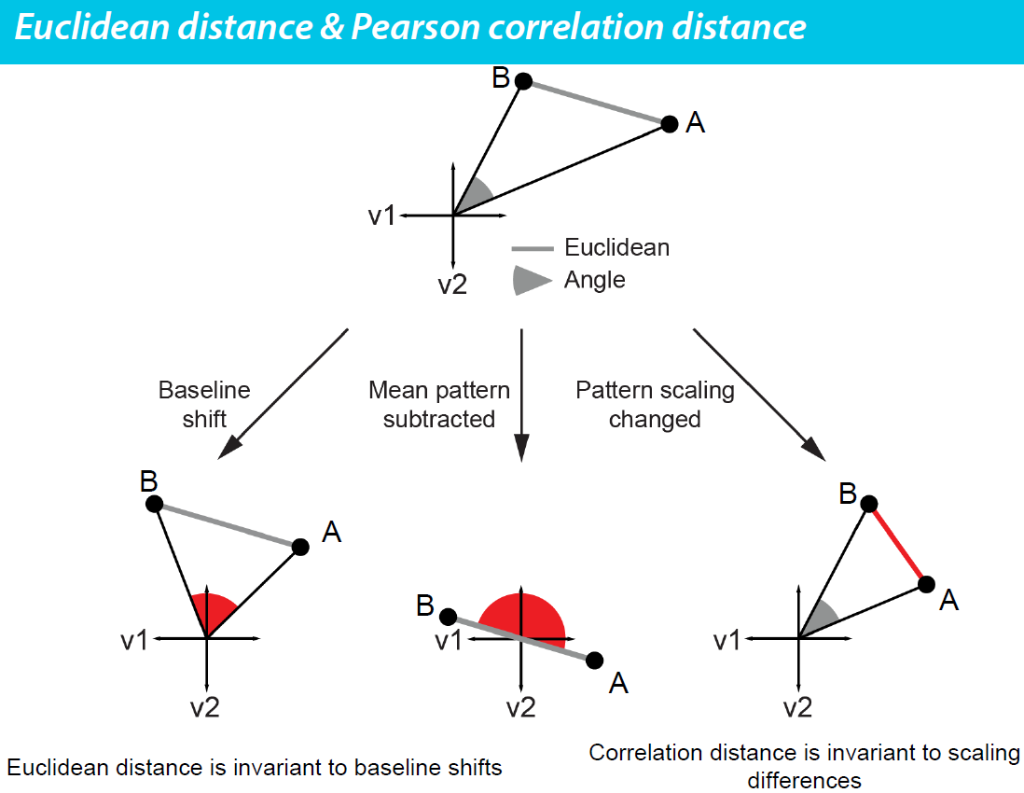
Image from Alex Walther, RSA workshop 2015
Notes:
Euclidean distance is more intuitive, often easier to model (e.g. Gaussian distributions), and invariance to baseline shifts may be useful (e.g. to compare geometries across two runs with different baselines).

Slide 21
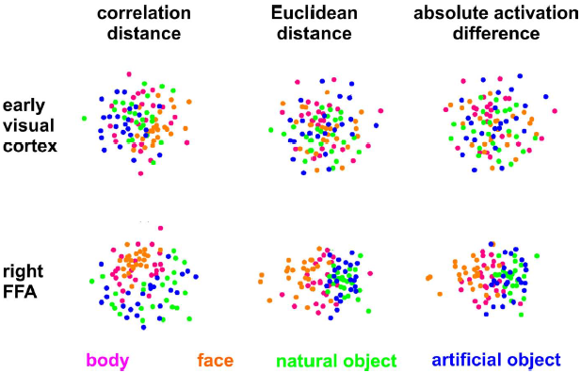
One example of effect in practice:
Kriegeskorte et al. 2008
Notes:
There may be better examples.
One issue is that the choice of distance measure could interact with the type of multidimensional scaling?
Would be useful to look at this in simulations.

Slide 22
Datasets and RDMs
How does The RSA Toolbox work?
data.Dataset [or data.TemporalDataset]
[ observations x channels [ x time] ]
from numpy array, pandas dataframe or .hdf5 file
Optional dataset/obs/channel descriptors, as dictionary of lists
Methods to: sort, split, subset, average
data.noise to estimate noise covariance/precision,
from measurements or residuals
demo_dataset
(create, describe,
and rearrange
datasets)
e.g. RDMs = rdm.calc_rdm(Dataset, method='euclidean‘)
RDMs = rdm.calc_rdm_movie(TemporalDataset, …)
RDMs = rdm.calc_rdm_unbalanced(…)
demo_dissimilarities
(create, access,
and plot data RDMs,
including crossnobis)
(~10 s)
rdm.RDMs
[ n x patterns x patterns ] or [ n x upper triangular vector]
Optional RDM/pattern descriptors, as dict of lists
Methods to:
concatenate, append, subsample and average RDMs
subsample, reorder, or sort patterns (i.e. conditions)
transform data (e.g. rank, or sqrt)
compare RDMs (e.g. types of correlation)
demo_unbalanced
(for data with missing values)
Notes:
First section of RDM demo repeats initial dataset creation from first demo.
For crossnobis dissimilarity, set e.g. cv_descriptor=‘runs’, noise=PrecisionMatrix
(If cv_descriptor is not specified, this will be guessed.)
Toolbox uses precision matrix rather than covariance matrix;
can be calculated from deviations of many measurements: noise.prec_from_measurements(dataset, method=‘shrinkage_eye’);
or from per-channel residuals calculated at a previous step: noise.prec_from_residuals(residuals,…)
Shrinkage is essential otherwise inversion essentially leads to almost random numbers!
rdm.calc_rdm defaults to “squared Euclidean” but
rdm.calc_rdm_unbalanced defaults to “Euclidean”??
To average (potential partial) RDMS, use:
partials = rsatoolbox.rdm.combine.from_partials([rdms1, rdms2])
## all rdms should have the same number of conditions, with NaNs for missing data ## then we rescale/align these based on pairs in common (put them in the same space) rescaledPartials = rescale(partials, method='evidence')
## then we can take a weighted average:
meanRDM = rescaledPartials.mean(weights='rescalingWeights')
There are also several demos called demo_fmri_..., which look good, but do not run because the relevant modules and data seem to be missing?

Slide 23
96 object images
Stimuli from Kiani et al. 2007, Kriegeskorte et al. 2008
Notes:
96 in original set, but 92 used in following slides...

Slide 24
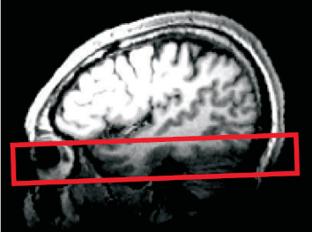
96-object-image fMRI experiment
25 axial slices covering ventral occipital and inferior temporal cortex (no gap)
voxel size: 1.95*1.95*2 mm³
TR: 2 s
Notes:
Or was it 92 out of the 96?

Slide 25
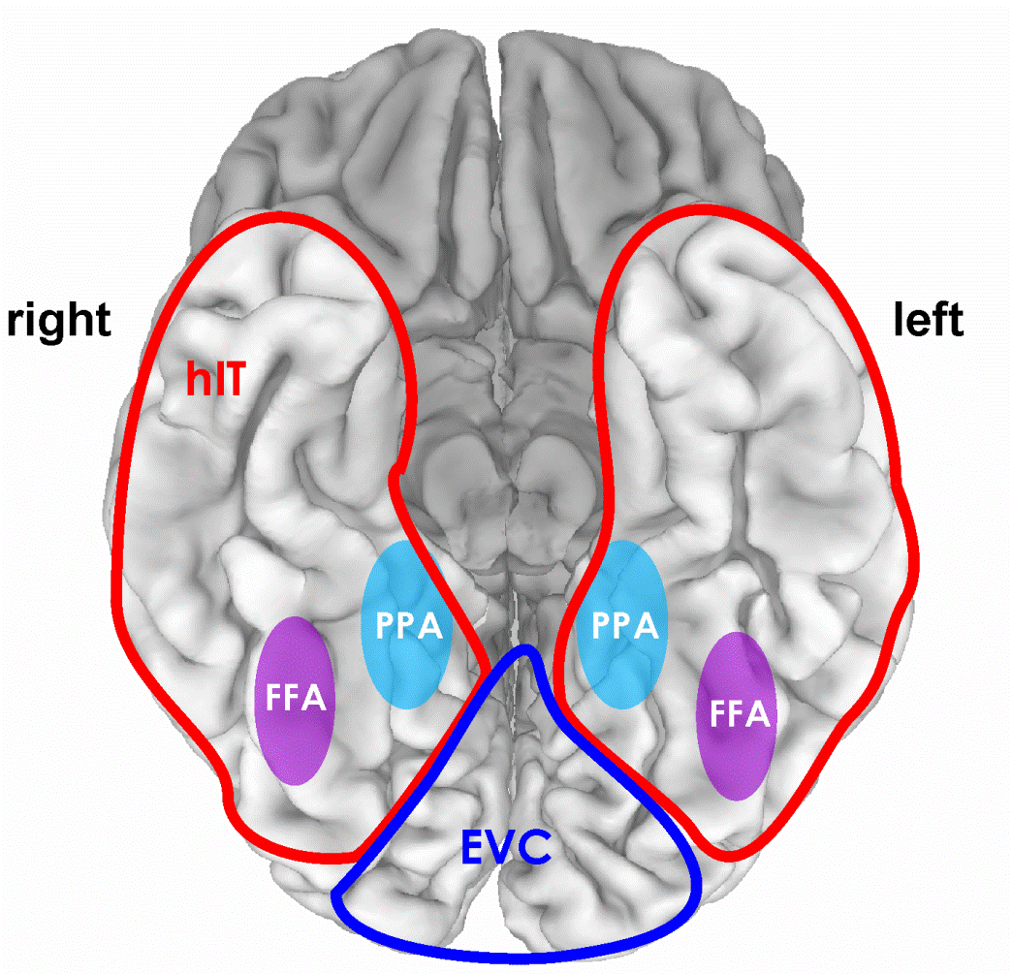
Example RDM of IT activity patterns, to be used in demo
92 object images
4 healthy humans
rapid event-related design (4 s SOA)
300 ms stimulus duration
object images spanned a visual angle of 2.9°
fixation-cross color-judgement task
12 runs/subject, each object image presented once per run
Kriegeskorte et al. 2008
Notes:
92 objects here

Slide 26
Example RDM of IT activity patterns, to be used in demo
human faces
animate-inanimate
dissimilarity
[percentile]
4 subjects’ average
Kriegeskorte et al. 2008
Notes:
Interpretability depends on the ordering of the stimuli
Consider whether or not to rank the dissimilarities

Slide 27
Cross-validated distance estimates
Linear Discriminant Contrast (LDC), aka Crossnobis estimator has two desired properties:
Multivariately noise-normalised
Like Mahalanobis distance
Potentially increases sensitivity
Cross-validated
Generalises
Not positively biased, with interpretable zero point
Requires data splitting (may not always be possible, and potentially reduces sensitivity)

Slide 28
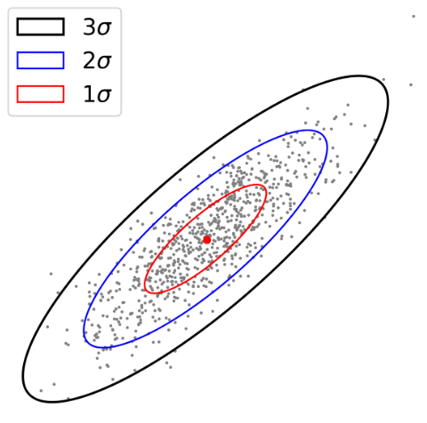
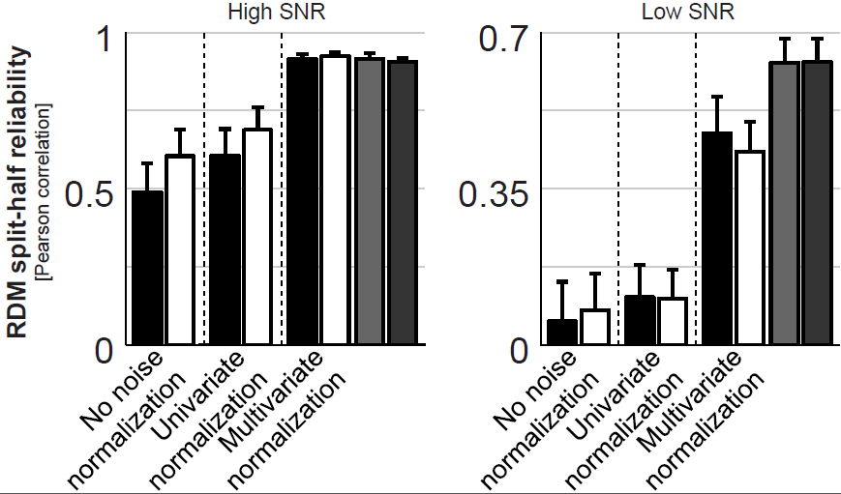
Noise normalisation
Noise normalisation of fMRI response patterns increases reliability of estimated pattern distances.
Univariate:
Divide each voxel’s beta weight by its standard error → t value
Multivariate:
Divide patterns by (square-rooted) covariance matrix → Mahalanobis distance (= multiply by inverse of matrix)
A
B
Image from Alex Walther, RSA workshop 2015
Notes:
Consider this multivariate normal distribution. Which of the points A and B is more representative of the distribution? A and B are equally distant from the centroid in terms of Euclidian distance, but A is three times closer to the centroid using Mahalanobis distance.

Slide 29
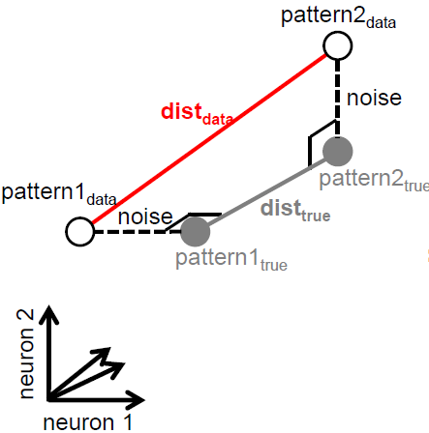
Cross-validated dissimilarity measures
Distances are positive
In high dimensional space, noise is likely orthogonal to pattern separation
Noise means distance measures are positively biased.
Image from
Niko Kriegeskorte
RSA workshop 2015

Slide 30
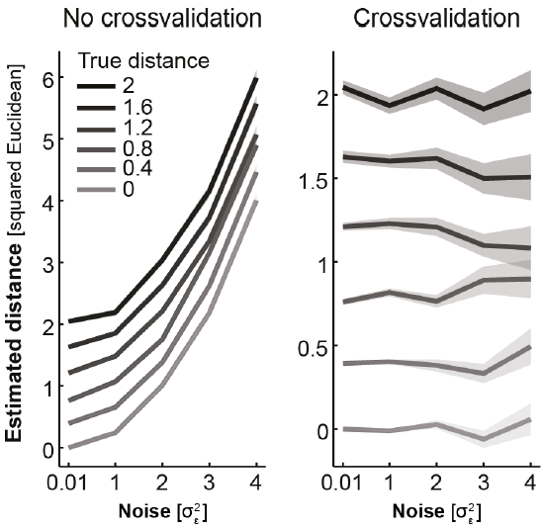
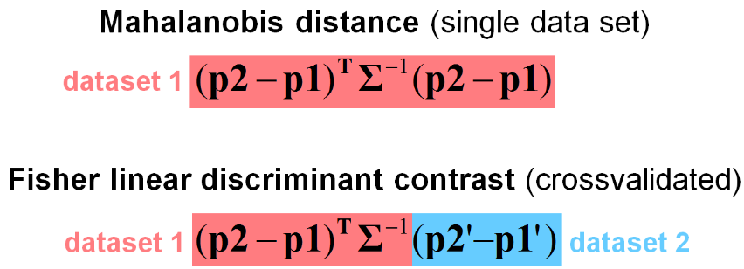
Cross-validated dissimilarity measures
Cross-validated dissimilarity measures are estimates of distances. So can be negative.
They are unbiased, have an interpretable zero point, and preserve ratio scale.
Noise covariance (Squared Euclidean distance if identity matrix)
from Alex Walther, RSA workshop 2015
LDC ~ dot product of difference vectors ~ cosine of angle between them = zero if orthogonal
Can divide by # voxels to compare ROIs of different sizes
LDt = LDC divided by its standard error
Nili et al. (2013)
Notes:
Dot product = inner product = scalar product
See fig 9c from Nili 2020

Slide 31
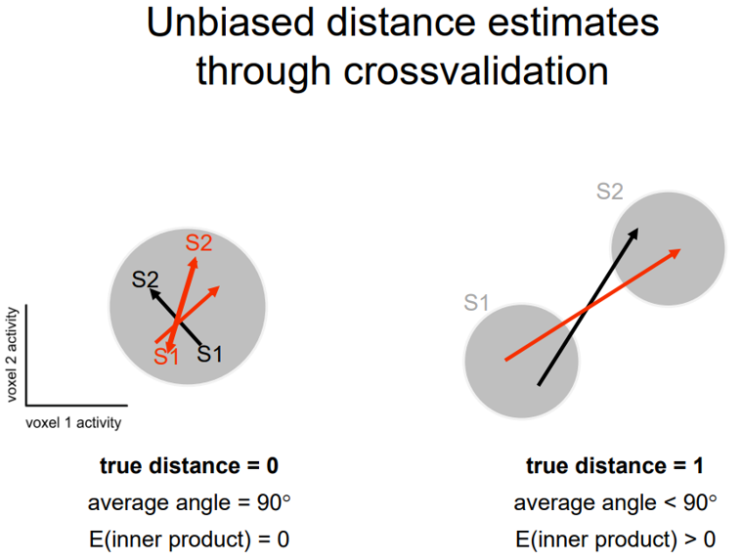
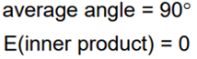
What if there is no mean separation of conditions, but one is noisier?
(adapted from Nili et al., 2020)
Separation in dataset A
Separation in dataset B
Pattern distribution for Stimulus 2
(noisier)
Pattern distribution for Stimulus 1
What would be the accuracy of a linear classifier?
Image from
Niko Kriegeskorte
RSA workshop 2015

Slide 32
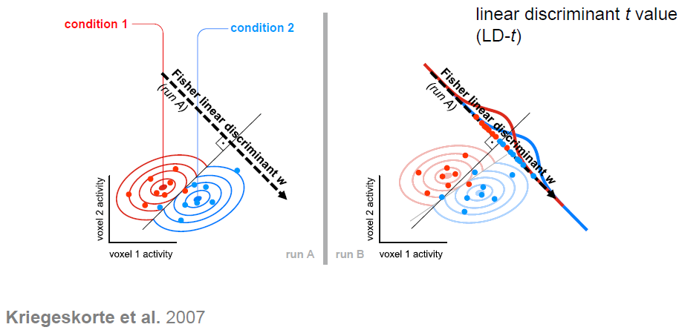
Compare with LDA classifier
Image from
Niko Kriegeskorte
RSA workshop 2015

Slide 33
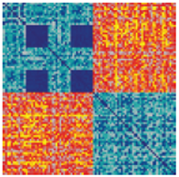
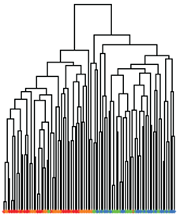
Ways to visualize representational structure
Representational dissimilarity matrix (RDM)
Contains all multidimensional dissimilarity information
Interpretability depends on order of stimuli/rows
(And colour scale/normalization)
Input to statistical inference
Multidimensional scaling (MDS) or other dimension-reduction
Finds low-dimensional representaion to best preserve the high-dimensional (metric or ranked) dissimilarities (i.e. plotted distance reflects neural dissimilarity)
Intuitive; directly interpretable
Discards information/distorts data; can assess with “Shepard plot” or “rubber bands”
Generally not used for statistical inference, but bootstrapped confidence ellipses could be added
Orientation is arbitrary; Procrustes transform can be used for alignment
Dendrogram
Defines multiscale clusters
Assumes hierarchical structure
Notes:
The dendrogram is not in the demo, but there are tools in scikit-learn for calculating and displaying this:
from sklearn.cluster import AgglomerativeClustering
from scipy.cluster.hierarchy import dendrogram

Slide 34
Datasets and RDMs
How does The RSA Toolbox work?
data.Dataset [or data.TemporalDataset]
[ observations x channels [ x time] ]
from numpy array, pandas dataframe or .hdf5 file
Optional dataset/obs/channel descriptors, as dictionary of lists
Methods to: sort, split, subset, average
data.noise to estimate noise covariance/precision,
from measurements or residuals
demo_dataset
(create, describe,
and rearrange
datasets)
e.g. RDMs = rdm.calc_rdm(Dataset, method='euclidean‘)
RDMs = rdm.calc_rdm_movie(TemporalDataset, …)
RDMs = rdm.calc_rdm_unbalanced(…)
demo_dissimilarities
(create, access,
and plot data RDMs,
including crossnobis)
rdm.RDMs
[ n x patterns x patterns ] or [ n x upper triangular vector]
Optional RDM/pattern descriptors, as dict of lists
Methods to:
concatenate, append, subsample and average RDMs
subsample, reorder, or sort patterns (i.e. conditions)
transform data (e.g. rank, or sqrt)
compare RDMs (e.g. types of correlation)
demo_unbalanced
(for data with missing values)
demo_rdm_vis…
(plot RDM with
formatted image icons;
scatterplot e.g. MDS)
Notes:
[*args in function definitions treats args as a tuple of variable inputs
**kwargs treats kwargs as a keyword dict of optional arguments]
In demo_rdm_vis…, for final scatterplot, try:
swapping image icons for string or marker
swapping MDS for iso (fast) or tSNE (slow)
See demo_annotated_rdm_plot, for an example of how to add overlays/contours to RDMs.

Slide 35
Comparing geometries – an example “model RDM” from Marieke Mur 2013
How well do brain representations and subjective experience match?
Notes:
The power of RSA is in comparing geometries…

Slide 36
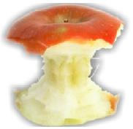
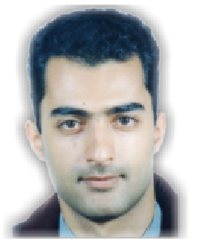
Conventional method: Pairwise similarity ratings
How similar are these objects?
very similar
very dissimilar
0
5
To make a full RDM from many pairwise dissimilarities would take a long time!
96
0
0
0
0
0
96
0
0
0
0
96 x 95 / 2 = 4560 pairs
0
0
0
4560 * 4 s = 5 hours per subject
similarity-judgment RDM

Slide 37
2D arrangement by dissimilarity
RDM
multidimensional
scaling
inverse
multidimensional
scaling
Goldstone, 1994; Risvik et al., 1994

Slide 38
Multi-object arrangement (MA) method
Kriegeskorte & Mur 2012
Subjects arrange objects in 2D by mouse drag-and-drop.
More efficient than pairwise similarity ratings.
Subjects arrange objects in the context of the other objects in the set.
16 healthy human subjects
each subject performed one 1-hour session (outside the scanner)

Slide 39
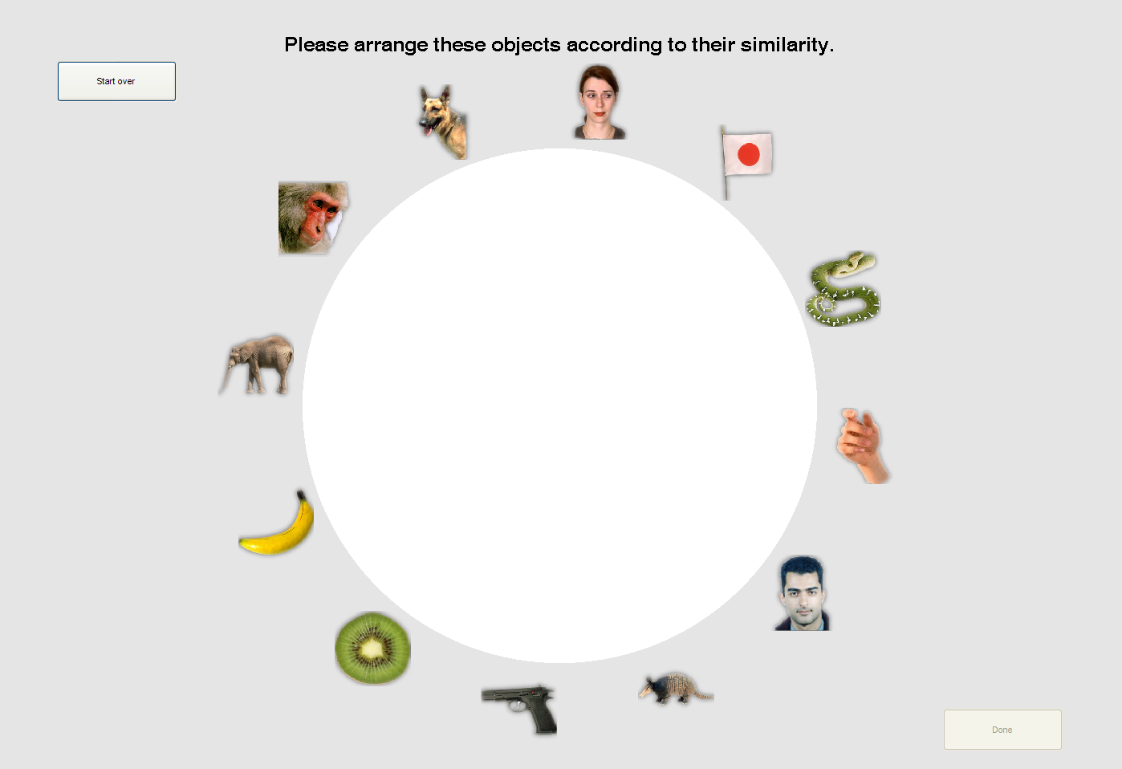
Please arrange these objects according to their similarity

Slide 40
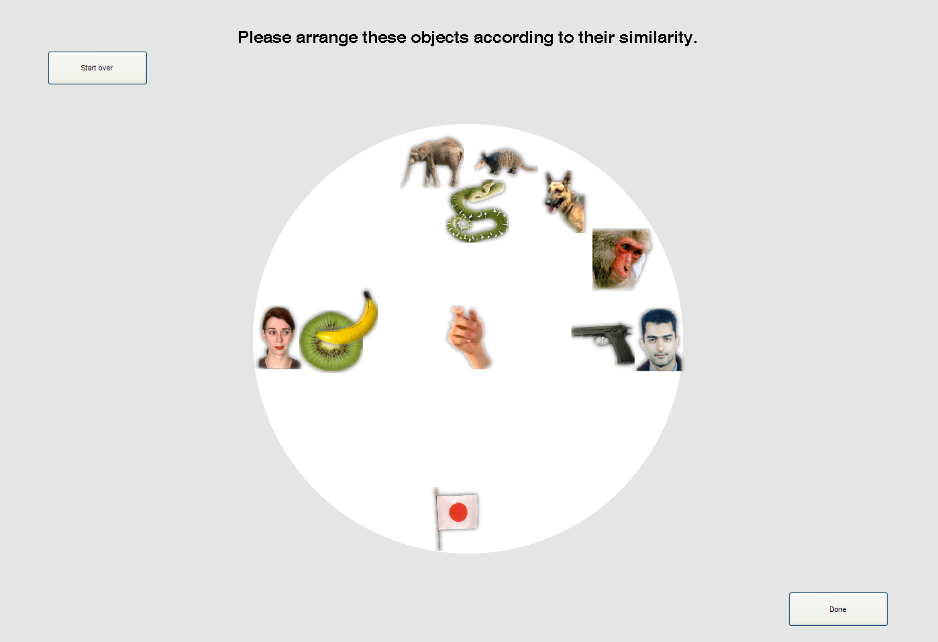
Please arrange these objects according to their similarity

Slide 41
human IT
similarity judgments

Slide 42
2D arrangements by dissimilarity
human IT
similarity judgments
Notes:
Similarity judgements have more and stronger categories
Perhaps because IT is just one brain region, whereas behaviour is downstream integration of distinctions from many brain regions?
(all 96 objects here)

Slide 43
human IT
similarity judgments
animate
inanimate
animate
inanimate
human
nonhuman
face
body
natural
artificial
face
body

Slide 44
Comparing RDMs
96
96
0
0
0
0
0
0
0
0
0
0
96
0
96
0
0
0
0
correlate
dissimilarities
0
0
0
0
0
0
0
0
0
Brain
Judgments
(“model RDM”)
Non-linear relationship might be expected, so rank correlation (Spearman/Kendall tau-a) often preferred
Therefore RDMs often rank transformed for display
RDM entries are not independent, so statistical inference must be done across e.g. subjects, or using condition permutation/bootstrap
But, covariance can be calculated and used to pre-whiten RDM
Can also use multiple regression to predict data RDM from model components
Can compare model geometries with 2nd-order RDM

Slide 45
Models and fitting
How does The RSA Toolbox work?
e.g.:
RDM = rdm.get_categoricalrdm([‘A’, ’A’, ‘V’, ‘V’])
Think of the “model” as a set of predictor RDMs (e.g. GLM design matrix) and a method to “fit” their weights (e.g. OLS, NNLS).
“Predict” returns a prediction based on particular weights
“Fit” estimates the weights, by “comparing” to single data RDM
These functions rarely need to be called directly…
model.ModelFixed(‘name’, RDM)
model.ModelFixed
or model.ModelWeighted
or model.ModelSelect
or model.ModelInterpolate
Methods to:
“predict” (an RDM)
“fit” (in various ways)

Slide 46
Some key components: Inference
How does The RSA Toolbox work?
For statistical inference we want to test the reliability of
(1) the similarity between model and data RDM
(2) the difference between model fits.
In simplest case (fixed models; independent subjects), can use 1-sample & paired t-test:
Result = inference.eval_fixed(ModelsFixed, RDMs, method='corr_cov')
To generalise across conditions/patterns (non-independent), could bootstrap:
Result = inference.eval_bootstrap_pattern(Models, RDMs, …)
If fits are biased (e.g. flexible or constrained parameters), they can be cross-validated across splits of subjects and conditions (needing dual bootstrap & >5 conditions). E.g.:
Result = inference.eval_dual_bootstrap(Models, RDMs,
k_pattern=4, K_rdm=2, N=1000, …)
demo_bootstrap:
load & view model RDMs; “fixed” & “selection” model comparison; cross-validation & bootstrap
(~2.5 minutes)
Notes:
See demo_flexible_models for an example of a weighted model (although this is incomplete).
Crossvalidation “training and test sets…should not share either subjects or stimuli”
Bootstrapping subjects is usually unnecessary because they are independent.
Bootstrapping patterns and subjects separately, is noisy/conservative, so “dual bootstrap” is recommended in this case
(see “Statistical Inference on Representational Geometries”, Schutt et al. 2023, eLife);
but this is less powerful than just bootstrapping the patterns?
To run cross-validation without bootstrap, could do:
train_set, test_set, ceil_set = inference.sets_leave_one_out_rdm(rdms)
inference.Result = inference.crossval(models, rdms, train_set, test_set, ceil_set=ceil_set, method='corr')
What is the difference between:
inference.eval_dual_bootstrap()
and
inference.bootstrap_crossval() ?
Input parameters are basically the same, except the latter has the option of which dimension to bootstrap (RDMs, patterns or both). This is faster but may not include the “dual bootstrap” correction? Does dual_bootstrap include the correction for cross-validation sampling? Yes. So, dual_bootstrap should always be used unless only need to bootstrap a single dimension?
inference.bootstrap_cv_random() is apparently “even more optimised” version of inference.bootstrap_crossval()
Presumably, eval_dual_bootstrap_random is optimised version of inference.eval_dual_bootstrap()? It also has the boot_type option. But it seems to return larger error bars, no noise ceiling, and I don’t understand the difference between n_ and k_ inputs.
So, generally, I prefer eval_dual_bootstrap()?

Slide 47
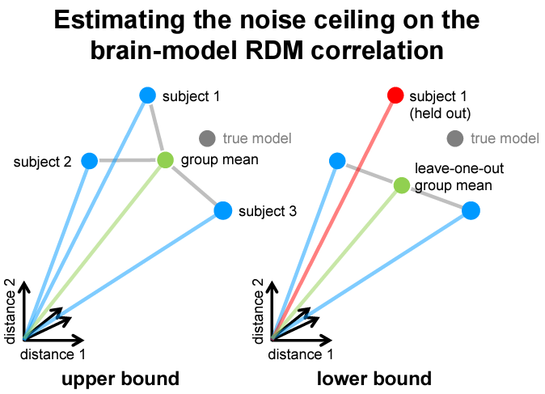
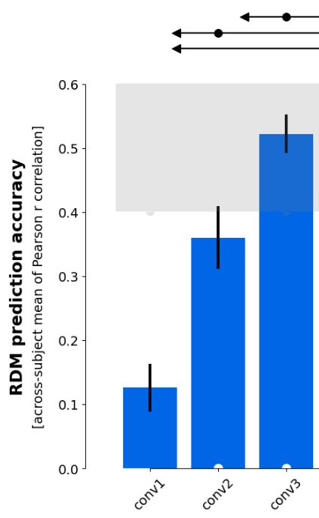
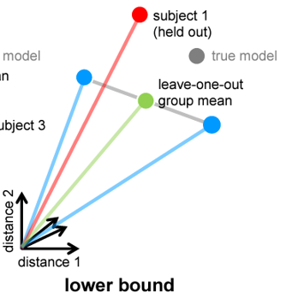
Nili et al. (2014)
Group mean RDM is best possible model (given the data) for comparing each subject to
Positively biased, because comparison subject included in mean
Do we need a better model, or better data?
Leave-one-out mean removes this dependence, but is negatively biased because it doesn’t use all the data

Slide 48
Some key components: Visualization
How does The RSA Toolbox work?
Plotting RDM data:
vis.show_rdm(RDMs, …)
vis.show_2D(RDMs, method, …)
Available methods (using sklearn.manifold defaults):
MDS (criterion of normalized_stress)
Isomap
t-SNE (what perplexity?)
given coordinates
Both can label conditions with “Icons” (as pattern descriptor in RDM object)
Comparing RDMs with scatterplots:
vis.rdm_comparison_scatterplot(RDMs, …)
Plotting statistical inference:
vis.plot_model_comparison(result, …)
vis.map_model_comparison(result, RDMs) [WARNING: CHANGES RDMS?]
various options for marking significance
Notes:
New visualisations in demos but not documentation:
rdm_comparison
model_map (passing in single subject data RDMs allows some sort of noise correction to reduce positive bias of data-model distances??; corr_cov method not yet handled)

Slide 49
Searchlights:
How does The RSA Toolbox work?
In rsatoolbox.util.searchlight…
centres, neighbours = get_volume_searchlight(mask)
RDMs = get_searchlight_RDMs(data_cXv, centres, neighbours, cond, …)
evaluate_models_searchlight(RDMs, models, eval_func)
Unfortunately this currently doesn’t seem to work with crossnobis dissimilarities, or with CV/bootstrapped inference!
demo_searchlight_volume
create and run searchlight for simple fixed model;
visualise with nilearn
(~6.5 mins)
Notes:
For 3mm radius searchlights:
Creating searchlights took 9 s (faster for smaller searchlights)
Creating data RDMs took ~3 mins on VM (can’t be parallelised; faster for smaller searchlights)
Evaluating Spearman similarity to model took 24 s with 16 cores on CBU cluster (doesn’t vary much with searchlight size)
Evaluating Spearman similarity to model took ~2.5 mins with 4 cores on VM
evaluate_models_searchlight(RDMs, models) evaluates each RDM separately and returns list of results.
In contrast to inference.eval_fixed(models, RDMs) which returns the average comparison.
How would you call evaluate_models_searchlight() with an eval_func that requires inputs e.g. eval_dual_bootstrap??
Other demos:
To run demo_meg_mne, would need to:
‘pip install mne’
but may run into memory issues, and for me it crashes at multiple points.

Slide 50
Summary recommendations
Use LDC (AKA “crossnobis”) dissimilarity to build data RDMs
accounting for noise covariance improves sensitivity, assuming Gaussian noise
cross-validation centres null on zero, to remove positive bias
invariant to shifts/rotations (unlike angular measures)
for speed/simplicity, could use squared-Euclidean distance
Compare RDMs using:
cosine distance if cross-validated (0 is meaningful; scale is probably not)…
correlation otherwise (neither zero nor scale are meaningful)…
pre-whitened by known covariance (Diedrichsen et al., 2021)…
or Spearman ρ_{a} for minimal assumptions
Evaluate fixed models using t-tests across subjects
fast, simple & powerful
valid RFX inference, because correlations between RDMs can be systematically negative (cf. Allefeld et al. 2016)
Evaluate flexible/biased models using [dual-]bootstrapped [dual-]cross-validation
2 CV splits per bootstrap is enough to correct variance inflation
higher k across patterns is slower but more powerful? (need >2 pat per split)
k=2 across subjects seems best?

Slide 51
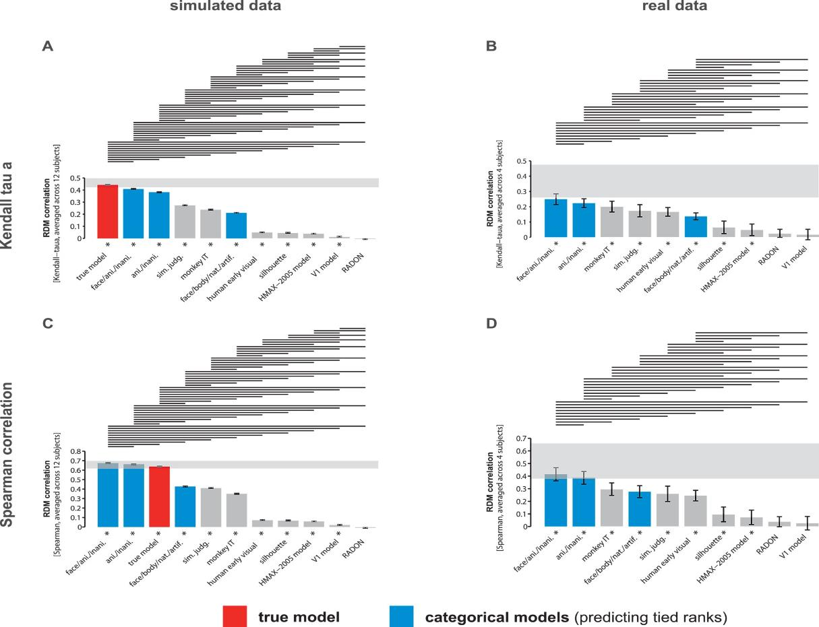
Spearman vs. Kendall tau-a for comparing RDMs
Kendall tau-a was previously recommended for models with ties.
Now a modified Spearman’s rho with random-tie-breaking is recommended
Nili et al. (2014)

Slide 52
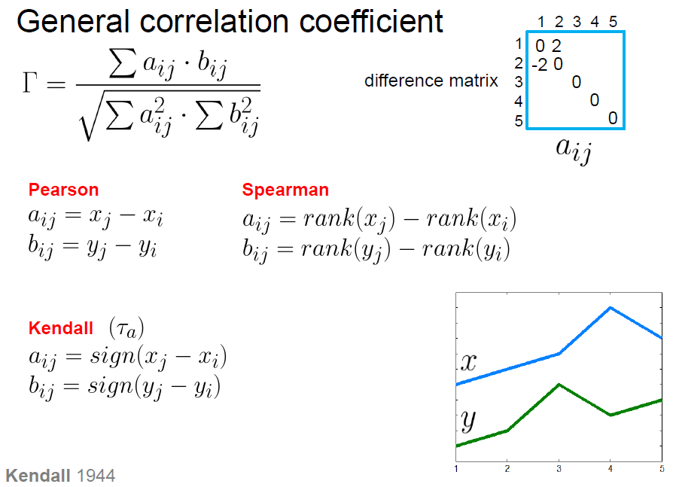
Image from Niko Kriegeskorte, RSA workshop 2015

Slide 53
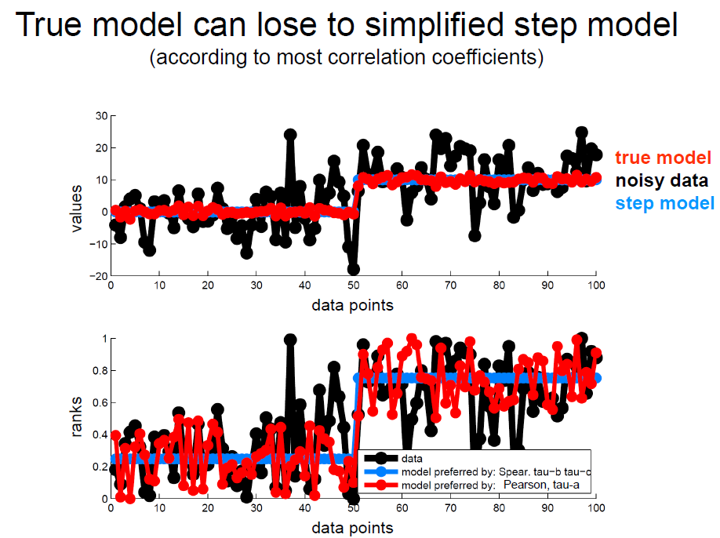
Image from Niko Kriegeskorte, RSA workshop 2015

Slide 54
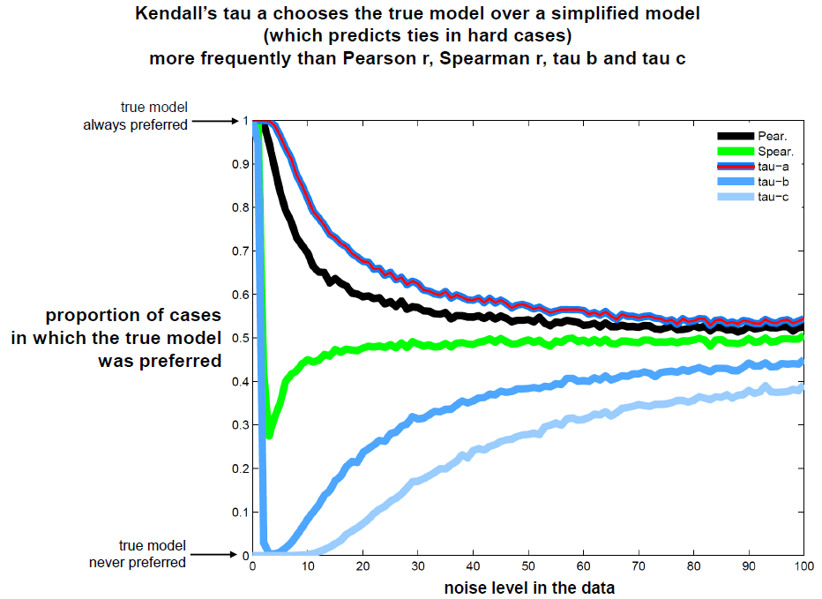
Image from Niko Kriegeskorte, RSA workshop 2015

Slide 55
A few example applications…

Slide 56
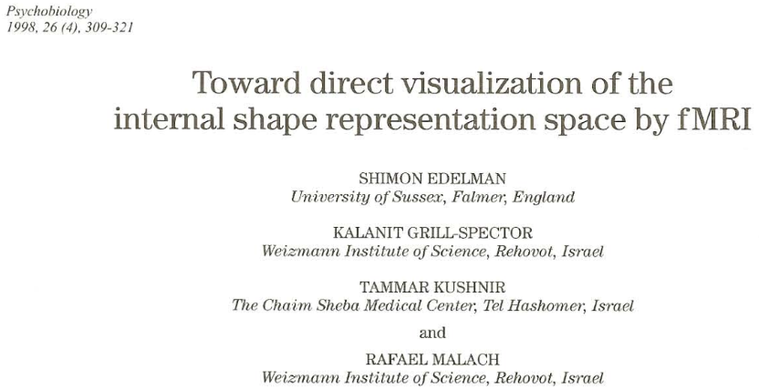
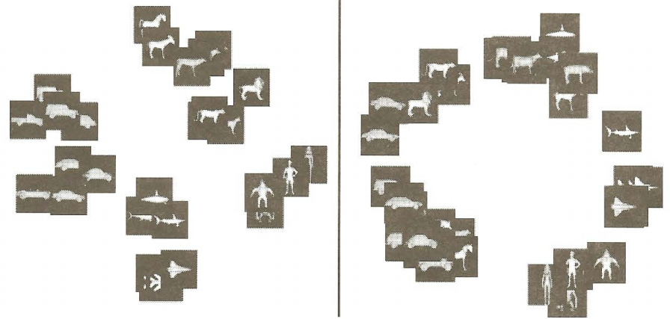

Slide 57
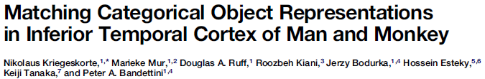
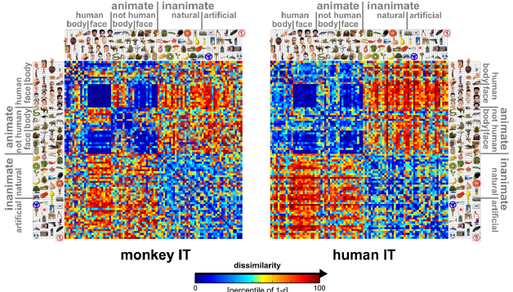
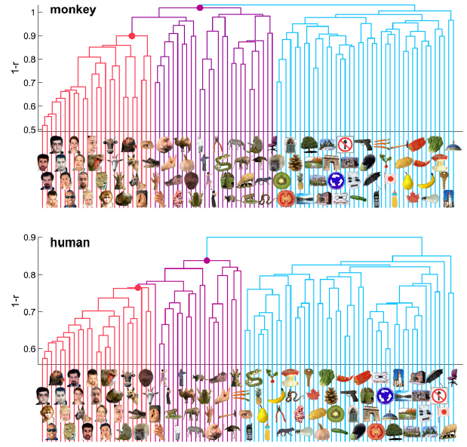
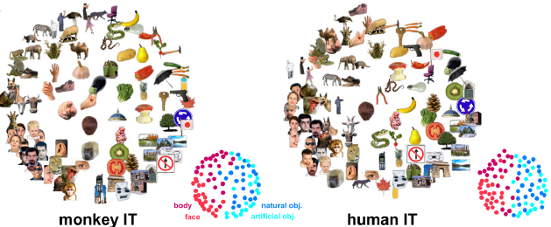

Slide 58
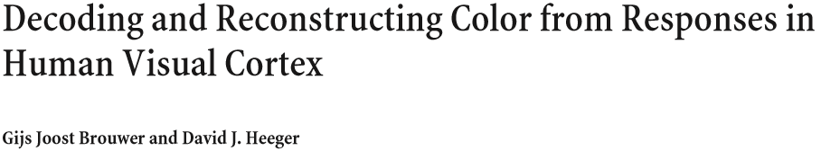
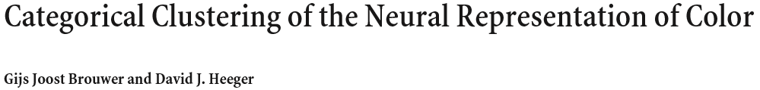
Brouwer & Heeger 2009, 2013

Slide 59
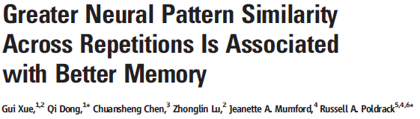
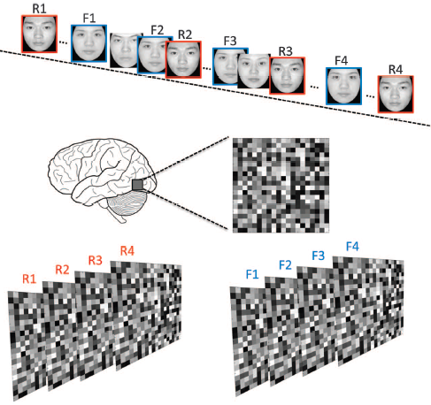
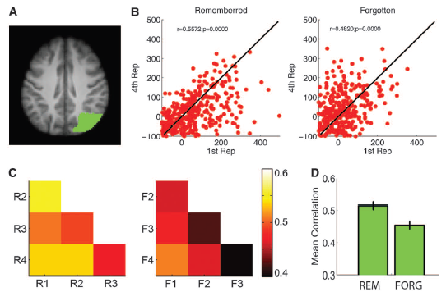

Slide 60
References (a very incomplete list)
RSA methods and review
Kriegeskorte N et al. (2008) Front Syst Neurosci 2(4): 1-28. [original methods paper]
Kriegeskorte N, Kievit R (2013) Trends Cogn Sci 17(8): 401-412. [recent review]
Related methods
Allefeld & Haynes (2014) NeuroImage 89: 345-357 [cross-validated MANOVA]
Diedrichsen et al. (2011) NeuroImage 55: 1665–1678 [pattern component modelling]
Diedrichsen et al. (2018) NeuroImage 180: 119-33 [pattern component modelling]
Reviews of representational approaches
Davis & Poldrack (2013) Ann. NY Acad. Sci. 1296:108-134
Haxby et al. (2014) Annu. Rev. Neurosci. 37:435-56
Kriegeskorte & Diedrichsen (2019) Annu. Rev. Neurosci. 42:407-32
RSA toolbox
Nili et al. 2014 PLoS Comput Biol
Schütt et al. 2023 eLife (https://elifesciences.org/articles/82566)

Slide 61
References (a very incomplete list)
Some example RSA applications in neuroscience
Edelman et al. (1998) Psychobiology 26(4) 309-321 [first application of MDS to fMRI]
Kriegeskorte N et al. (2008) Neuron 60: 1126-1141. [object vision: human - monkey]
Brouwer & Heeger (2009) J.Neurosci. 29(44):13992–14003 [colour coding]
Mur M et al. (2013) Front Psychol 4(128): 1-22. [object vision: brain - behaviour]
Xue G et al. (2010) Science 330: 97-101. [memory: forgotten vs remembered items]
Ward EJ et al. (2013) J Neurosci 33(37): 14749-14757. [memory: implicit vs explicit]
Ritchey M et al. (2013) Cereb Cortex doi:10.1093/cercor/bhs258. [memory retrieval]
Charest et al. (2014) PNAS 111(4): 14565-14570 [individual differences]
Cichy et al. (2014) Nature Neuroscience: 17, 455-62 [Fusing fMRI & MEG]
Mitchell & Cusack (2016) Scientific Reports 6:20232; DOI: 10.1038/srep20232 [mental imagery, and neuro-feedback]
Haxby et al. (2020) eLife: 9:e56601 [hyperalignment]
So many more…!

Slide 62
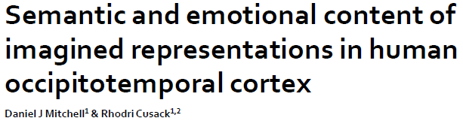
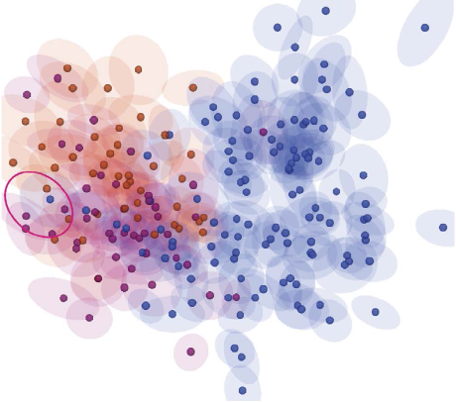



Extra demo data if time?
Mitchell & Cusack (2016) Scientific Reports 6:20232
200 objects, presented one each per condition
2 conditions (occasional cues to imagine knives or dolphin)
Tutorial data combined over subjects

Slide 63
Thank you for listening. Questions?
Daniel.Mitchell@mrc-cbu.cam.ac.uk

